Slide 1
Project Planning
Software Project Management
Presenter
  Mrs. Sharon Mose
  Email: sharonmoseh@gmail.com
Notes:
Opening Slide

Slide 2
SPM
Project Planning
Activity Planning
Introduction
Activity planning, sometimes referred to as scheduling, together with cost/financial planning are probably the major tools for the management of the project.
Activity planning will help to:
  Ensure that the appropriate resources will be available precisely when required.
  Avoid different activities competing for the same resource at the same time.
  Produce a detailed schedule showing when specific staff will be needed to carry out each particular activity.
  Produce a detailed plan against which actual achievement may be measured.
  Produce a timed forecast.
  Re-plan the project during its life to correct drift from a target.

Slide 3
SPM
Project Planning
Activity Planning
Methods for activity planning
Precedence analysis
Gantt charts
Network techniques (i.e. PERT / CPM)
  Activity-on-arrow networks
  Activity-on-node networks

Slide 4
SPM
Project Planning
Activity Planning
Precedence analysis
This analysis must be done before an activity plan can be produced.
It reviews the activities that are to be carried out.
It decides and indicates what activities must be carried out before a particular activity can start.

Slide 5
SPM
Project Planning
Activity Planning
Gantt charts
They were developed by Henry Gantt, around 1917.
A Gantt chart shows planned and actual progress for a number of tasks displayed against a horizontal time scale.
Advantages of Gantt charts:
  They are easy to produce/construct.
  Even though they may contain a great deal of information, they are easily understood.
  While they may require frequent updating, they are easy to maintain.
  Gantt charts provide a clear picture of the current state of a project.
They are very useful for use on less complex projects.
They do not represent well logical constraints.
They should be used to complement, not replace, network techniques.

Slide 6
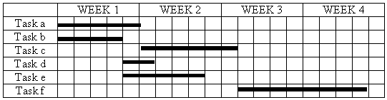
SPM
Project Planning
Activity Planning
Gantt charts (contd)
Draw a simple Gantt chart based on the following project data:
    Tasks Precedence Time
    a - 5 days
    b - 4 days
    c a 6 days
    d b 2 days
    e b 5 days
    f c,d 8 days

Slide 7
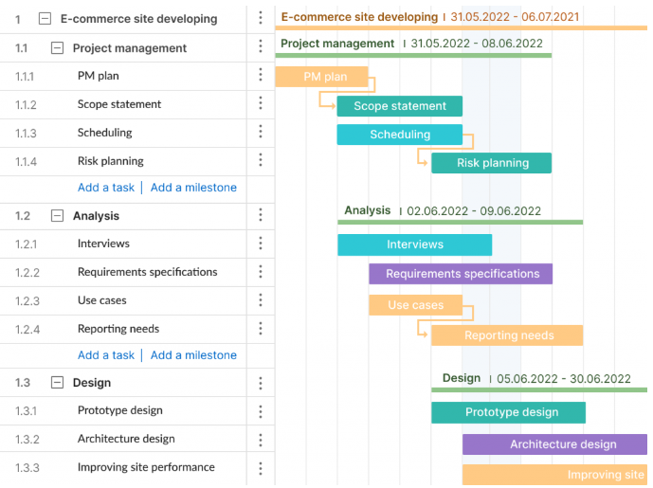
SPM
Project Planning
Activity Planning
Gantt charts (contd)
Example (GANTTPRO)

Slide 8
SPM
Project Planning
Activity Planning
Network techniques
The basic approach entails forming a network of activity and event relationships.
The network should portray the sequential relations between the tasks in a project, in time as well as function.
Benefits of network techniques/approach:
  It is a consistent framework for planning and many other project aspects including monitoring and controlling.
  It illustrates the interdependence of all the project tasks.
  It denotes the times when specific individuals must be available for a given task.
  It aids in ensuring that the proper communications take place within the project and with the organization.
  It determines an expected project completion date.
  It identifies critical activities that, if delayed, will delay the project completion time.

Slide 9
SPM
Project Planning
Activity Planning
Network techniques (contd)
Benefits of network techniques/approach (contd):
  It identifies activities (with slack) that can be delayed for specific periods without delaying the project completion time.
  It determines the dates on which tasks may be started, or must be started if the project is to stay on schedule.
  It illustrates which tasks must be coordinated to avoid resource timing conflicts.
  It illustrates which tasks may be run, or must be run, in parallel to achieve the expected project completion date.
  It relieves some interpersonal conflict by clearly showing task dependencies.

Slide 10
SPM
Project Planning
Activity Planning
Network techniques (contd)
Examples of network techniques are PERT and CPM.
PERT (Program Evaluation and Review Technique)
PERT is a way to visualize project tasks’ flow in the project and estimate the timeline based on their assumed duration.
This technique also illustrates dependencies between tasks.
You can use these methods to calculate the assumed start and finish dates, based on the known scope of the project
CPM (Critical Path Method)
The Critical Path Method helps you uncover the longest possible timeline for the project, as well as the shortest one. With the CPM you’ll be able to mark critical tasks and the ones that may float.

Slide 11
SPM
Project Planning
Activity Planning
Network techniques (contd)
Some terminology:
Activity - A specific task or set of tasks that are required by the project. Activities use up resources and take time to complete.
Event - The result of completing one or more activities. It is an identifiable end state occurring at a particular time. Events use no resources. Events are instances in time, points on the network, or conditions of a system that can be recognized.
Network - The combination of all activities and events. It defines the project and the activity precedence relationship. Arrow heads placed on the lines indicate the direction of flow. Before an event can be realized, all the activities that immediately precede it must be completed.
Path - The series of connected activities (or intermediate events) between events in a network.
Critical - Activities, events, or paths which, if delayed, will delay the completion of the project. A project’s critical path is the sequence of critical activities that connect the project’s start event to its finish event.

Slide 12
SPM
Project Planning
Activity Planning
Network techniques (contd)
An activity can be in any of these conditions:
  It may have a successor(s) but no predecessor(s) - starts a network.
  It may have a predecessor(s) but no successor(s) - ends a network.
  It may have both predecessor(s) and successor(s) - in the middle of a network.
The interconnections depend on the technological relationships described in the action plan (recall: what is to be done [activities], when it is to be done [schedules], who or what is needed [resources needed]).

Slide 13
SPM
Project Planning
Activity Planning
Network techniques (contd)
Network syntax:
  Time moves from left to right.
  Nodes are numbered sequentially.
  A network may not contain loops.
  Precedents are the immediate preceding activities.
  Dummy activities can be used to indicate a particular precedence.
Question: What are dummy activities?

Slide 14
SPM
Project Planning
Activity Planning
Network techniques (contd)
Network techniques comprise:
  Activity-on-Arrow (AOA) network models/diagrams
  Activity-on-Node (AON) network models/diagrams

Slide 15
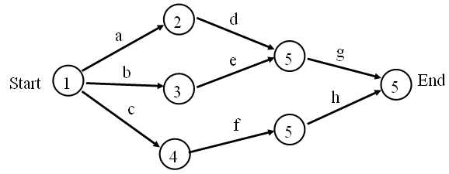
SPM
Project Planning
Activity Planning
Activity-On-Arrow (AOA) network models/diagrams
Activity-on-arrow (AOA) network models use arrows to represent activities while nodes represent events.
Here is a simple example of an activity-on-arrow network model/diagram.

Slide 16
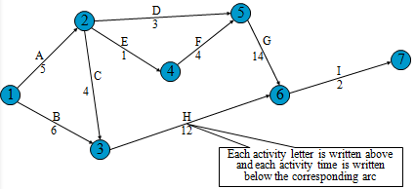
SPM
Project Planning
Activity Planning
Activity-On-Arrow (AOA) network models/diagrams (contd)
Activity-on-arrow (AOA) network with time
Note we will this example later
Question: Show the critical path

Slide 17
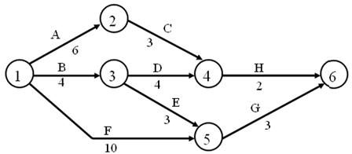
SPM
Project Planning
Activity Planning
Activity-On-Arrow (AOA) network models/diagrams (contd)
Given the following project data, draw an activity-on-arrow network.
    Tasks Precedence Time
    A - 6 weeks
    B - 4 weeks
    C A 3 weeks
    D B 4 weeks
    E B 3 weeks
    F - 10 weeks
    G E,F 3 weeks
    H C,D 2 weeks
Question: Show the critical path

Slide 18
SPM
Project Planning
Activity Planning
Activity-On-Node (AON) network models/diagrams
Activity-on-Node (AON) networks use nodes to represent activities with arrows to show precedence relationships.
The choice between AOA and AON representation is largely a matter of personal preference.
AON representation is becoming more common as it is used by many project planning software packages.
Syntax for AON networks is primarily the same as for AOA networks, except that AON networks do not allow dummy activities in their representation.

Slide 19
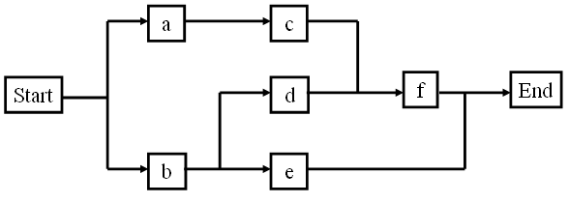
SPM
Project Planning
Activity Planning
Activity-On-Node (AON) network models/diagrams (contd)
Draw an activity-on-node network for the following project data:
  Tasks Precedence Time
  a - 5 days
  b - 4 days
  c a 6 days
  d b 2 days
  e b 5 days
  f c,d 8 days

Slide 20
SPM
Project Planning
Financial Planning
Introduction
Research indicates that IT projects have a poor track record for meeting budget goals; we therefore need to pay close attention to the budget goals in IT projects.
Cost is a resource sacrificed or foregone to achieve a specific objective or something given up in exchange. Costs are usually measured in monetary units.
Project cost management includes the processes required to ensure that the project is completed within an approved budget. Project cost management processes include:
  Resource planning: determining what resources (people, equipment, and materials) a project team should use to perform project activities and the quantities of each resource.
  Cost estimation: developing an approximation or estimate of the costs of the resources needed to complete a project.
  Cost budgeting: allocating the overall project cost estimate to individual work items to prepare budgetary estimates and to establish a cost baseline for measuring project performance.
  Cost control: controlling changes to the project budget.

Slide 21
SPM
Project Planning
Financial Planning
1. Resource planning
Resource planning involves determining what resources (people, equipment, and materials) a project team should use to perform project activities and the quantities of each resource.
The people who help determine what resources are necessary include people who have experience and expertise in similar projects and with the organization performing the project.

Slide 22
SPM
Project Planning
Financial Planning
2. Cost estimation
Cost estimation involves developing an approximation or estimate of the costs of the resources needed to complete a project.
Cost estimates must be taken seriously for projects to complete within budget constraints.
Types of cost estimates are:
  Rough order of magnitude (ROM) estimate;
  Budgetary estimate; and
  Definitive estimate
Question: Define the above types of cost estimates

Slide 23
SPM
Project Planning
Financial Planning
3. Cost budgeting
This involves allocating the overall project cost estimate to individual work items to prepare budgetary estimates and to establish a cost baseline for measuring project performance.
These work items are based on the WBS for the project.
An important goal of cost budgeting is to produce a cost baseline, which is a time-phased budget that project managers use to measure and monitor cost performance.
Examples of budget

Slide 24
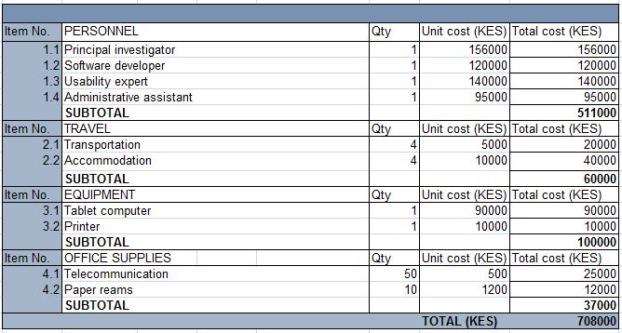
SPM
Project Planning
Financial Planning
3. Cost budgeting
Example: Budget for a website development project

Slide 25
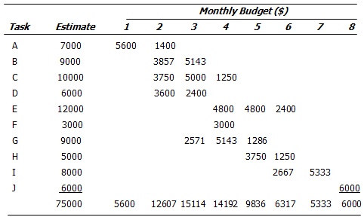
SPM
Project Planning
Financial Planning
3. Cost budgeting
Example of project budget (by task and month)

Slide 26
SPM
Project Planning
Financial Planning
4. Cost control
This involves controlling changes to the project budget.
Project cost control includes:
  Monitoring cost performance.
  Ensuring that only appropriate project changes are included in a revised cost baseline.
  Informing project stakeholders of changes to the project that will affect costs.
The cost control process realizes documents such as revised cost estimates, budget updates, corrective action, lessons learned, etc.

Slide 27
SPM
Project Planning
Financial Planning
Financial evaluation
Techniques such as the following ones are used:
Net profit: total income (or revenue) - total cost (or expenditure)
Payback period: time taken to break even
Return on investment (ROI): compares investment required with net profitability i.e. ROI= average annual profit / total investment x 100
Net present value (NPV):
  NPV discounts future cash flows to current money values, by using a percentage rate called the discount rate (or discount factor).
  The formula for discounted or future cash flows = value in year t / (1+r)^{t}, where r is the discount rate expressed as a decimal value and t is the number of years in the future
  Note NPV = (sum of all the discounted cash flows)
  Example (next slide)
  Question: Do we prefer NPV –ve, +ve, etc?
etc

Slide 28
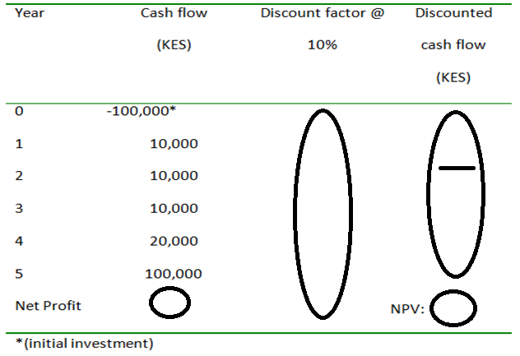
SPM
Project Planning
Financial Planning
Financial evaluation
NPV example?
e.g.10,000/(1+0.1)²

Slide 29
SPM
Project Planning
AOB
Any Questions?
Notes:
Introduction

